Slide 1
Expected Improvement

Slide 2
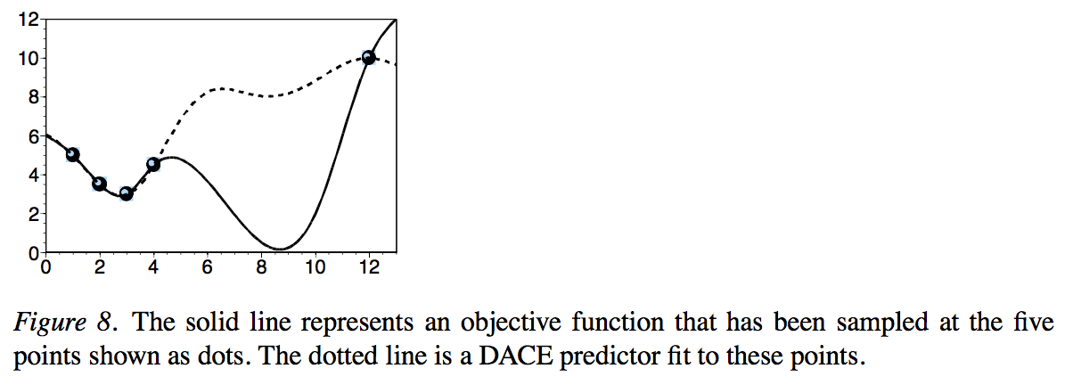
Why using Expected Improvement
Simplest way for optimization in case of using response surface
-> fit a surface and then find the minimum of the surface
DACE predictor is minimized at the local minimum (x = 2.8)
But, this method easily lead to a local minimum

Slide 3
Why using Expected Improvement
Problem with simply finding the minimum of the DACE surface
-> Not acknowledge our uncertainty about that surface
-> Puts too much emphasis on exploiting the predictor
-> No emphasis on exploring points where we are uncertain
To eliminate this problem
-> Put some emphasis on sampling where we are uncertain as measured by standard error of the predictor

Slide 4
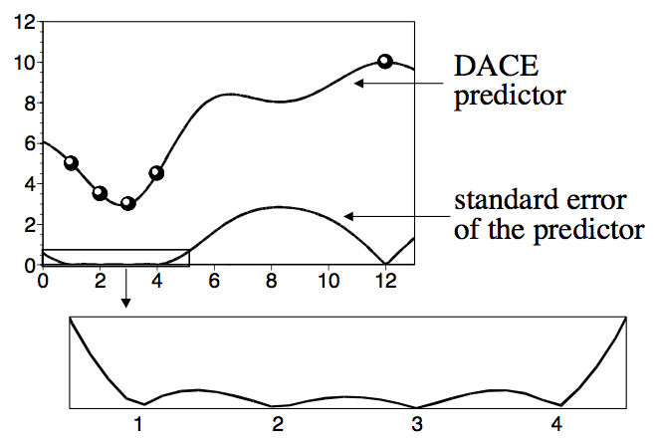
Why using Expected Improvement
Large number of sampled points around x = 2 (uncertainty)
-> Standard error of the predictor is very low in that region
Standard error go to zero at all the sampled points
Standard error is maximized around x = 8.3
-> This might be a good place to search from the point of view of global search
However, sampling x = 8.3 would be equivalent to putting all our emphasis on global search
-> this is just as bad than putting all our emphasis on local search

Slide 5

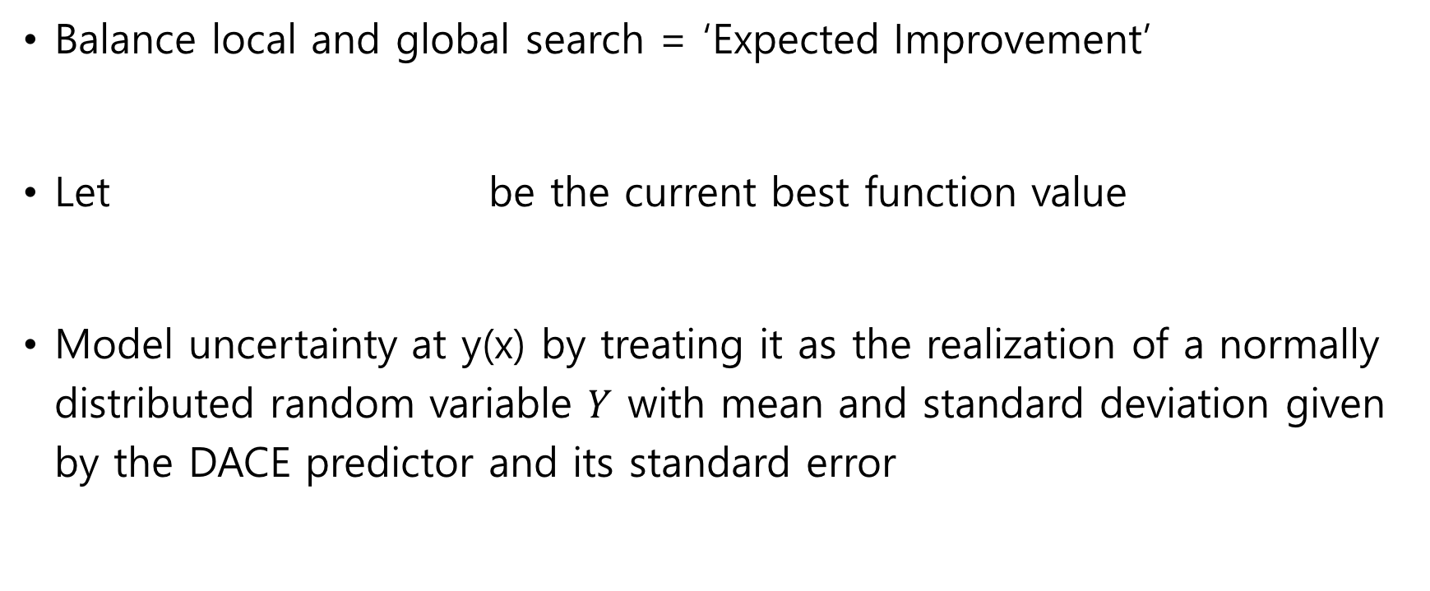
What is Expected Improvement
Balance local and global search = ‘Expected Improvement’
Let be the current best function value
Model uncertainty at y(x) by treating it as the realization of a normally distributed random variable $Y$ with mean and standard deviation given by the DACE predictor and its standard error

Slide 6
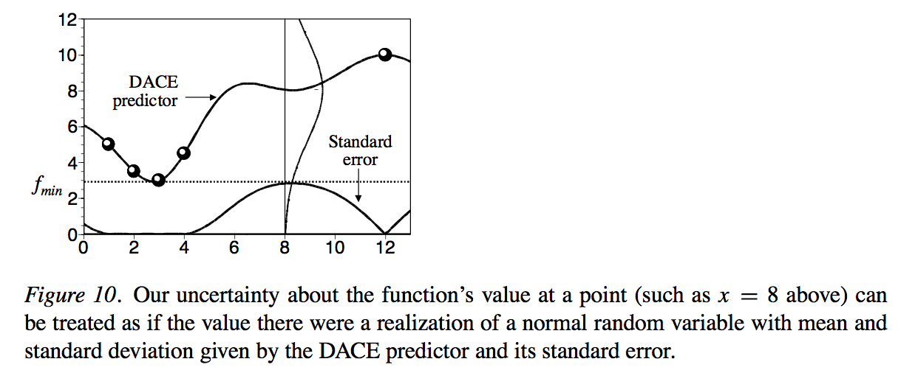
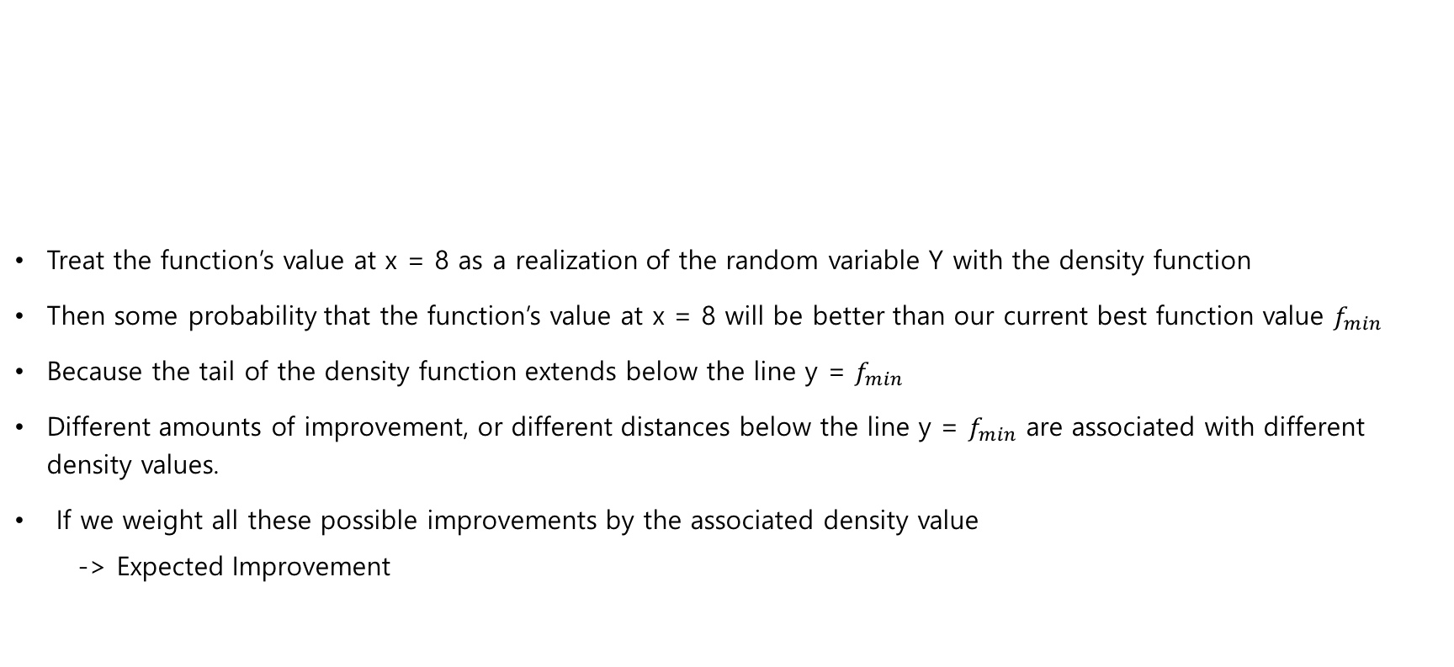
What is Expected Improvement
Treat the function’s value at x = 8 as a realization of the random variable Y with the density function
Then some probability that the function’s value at x = 8 will be better than our current best function value $f_{min}$
Because the tail of the density function extends below the line y = $f_{min}$
Different amounts of improvement, or different distances below the line y = $f_{min}$ are associated with different density values.
If we weight all these possible improvements by the associated density value
-> Expected Improvement

Slide 7

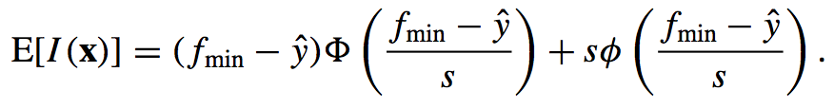
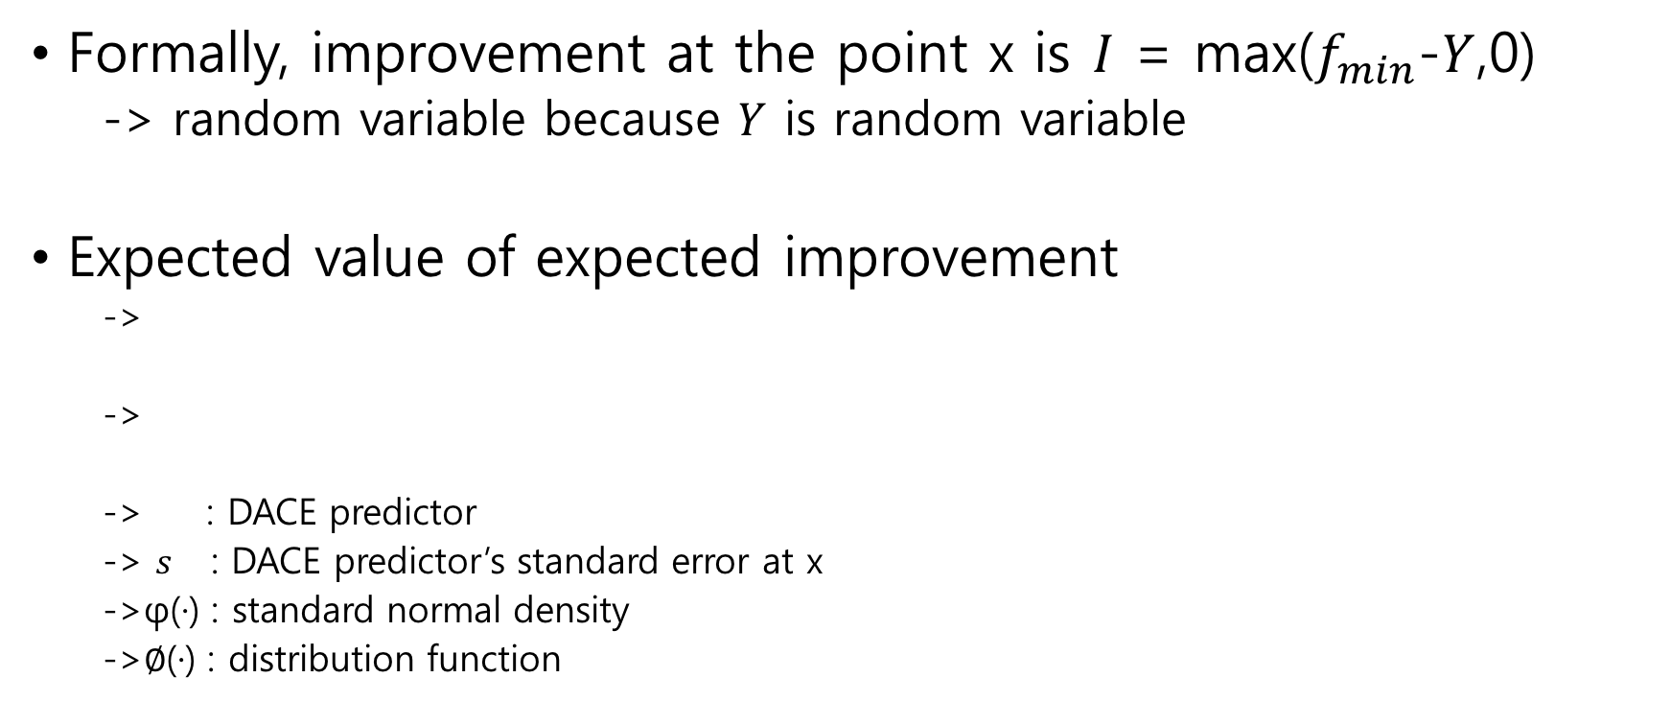
What is Expected Improvement
Formally, improvement at the point x is $I$ = max($f_{min}$-$Y$,0)
-> random variable because $Y$ is random variable
Expected value of expected improvement
->
->
-> : DACE predictor
-> $s$ : DACE predictor’s standard error at x
->φ(·) : standard normal density
->$∅$(·) : distribution function

Slide 8
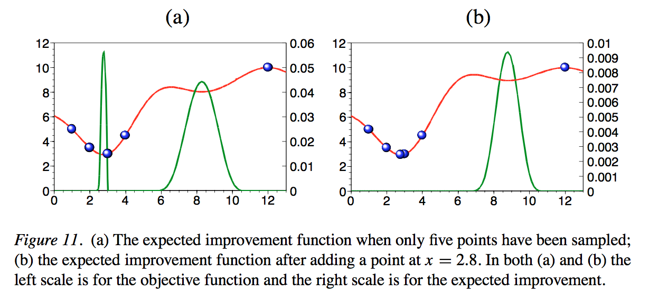
What is Expected Improvement
Two peaks at x = 2.8 and x = 8.3
Peak at x = 2.8 is higher => sample
Next iteration, EI is maximized at x = 8.8 -> driven to search globally

Slide 9
What is Expected Improvement
EI function is highly multi-modal
EI is zero at the sampled points and positive in between
Large are where EI is essentially zero and so appears quite ‘flat’
-> both these features makes optimizing the EI function with standard multistart approaches difficult and potentially unreliable

Slide 10
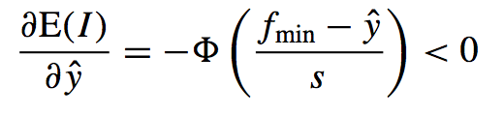


What is Expected Improvement
Lower bound
-> Derivative of E(I) as and express this $y^{L}$
Upper bound
-> Derivative of E(I) as s and express this $s^{U}$

